Slide 1
US Patent Phrase To Phrase Matching: Detect Novel Semantic Similarity (NSS) To Extract Meaningful Information From US Patent Applications
Anubhav Shankar Advisor: Professor Ming Shao

Slide 2
PHASES
Introduction
Approaches
Concepts
Result
Future Scope

Slide 3
MOTIVATION
To develop a thorough understanding of ML concepts, especially Natural Language Processing (NLP)
Develop and hone skills concerning data wrangling with a particular focus on Feature Engineering to make the data either analyzable or to introduce new variables for analysis
Become a Python power user and attain experience using specialized packages like PyTorch and other NLP-specific packages
Get familiar with Kaggle’s submission formats and, thus, modify the final output accordingly

Slide 4
ABSTRACT
Patents are a form of intellectual property granted in exchange for the public disclosure of new and valuable inventions.
The motivation of this undertaking is to detect/establish “novel semantic similarity (NSS).” NSS between phrases is a critical part of the patent evaluation to recognize if an invention has been described before.
The scope of this project goes beyond simple phrase-to-phrase matching. Contextual establishment of phrases is also essential.
For example, while the terms "bird" and "Cape Cod" may have low semantic similarity in everyday language, the likeness of their meaning is much closer if considered in the context of "house" or “scenery.”

Slide 5
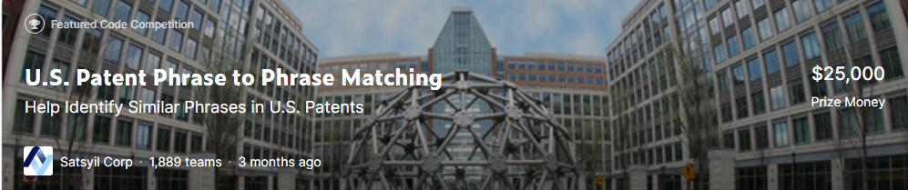
DATASET
For this project, I’ll use the competition dataset from Kaggle.

Slide 6
DATASET (CONTD.)
The dataset will consist of a Training and Testing set.
The training set will have 36,473 unique entries.
There will be two variants of the Testing dataset- seen and unseen.
Briefly, the “seen” dataset will have 36 unique records whose sole purpose is to examine the fundamentals of the prepared model
The “unseen” testing set will have ~12k unique records, which will gauge the model’s effectiveness
Important Note -> Both the testing datasets are provided by Kaggle. While the “seen” set is available for download, the “unseen” one resides on a remote server and is used to grade a particular submission.

Slide 7
DATASET – FEATURES OVERVIEW
Feature | Description
ID | Unique identifier for a pair of phrases
Anchor | The first phrase
Target | The second phrase
Context | the CPC classification (version 2021.05), which indicates the subject within which the similarity is to be scored
Score* | The similarity. This is sourced from a combination of one or more manual expert ratings.
*The score column/feature will not be present in the testing datasets. The remaining features, however, will be available.

Slide 8
EVALUATION
The primary methodology for evaluation will be Pearson’s Correlation Coefficient to grade the predicted and actual similarities
Here’s a detailed explanation of the Evaluation in action:
1.0 - Very close or exact match.
0.75 – Close synonym, e.g., “mobile phone” vs. “cellphone.” This also includes abbreviations, e.g., “TCP” -> “transmission control protocol."
0.5 - Synonyms that don’t have the same meaning (same function, same properties). This includes broad-narrow (hyponym) and narrow-broad (hypernym) matches
0.25 – Somewhat related, e.g., the two phrases are in the same high-level domain but are not synonyms.
0.0 - Unrelated

Slide 9
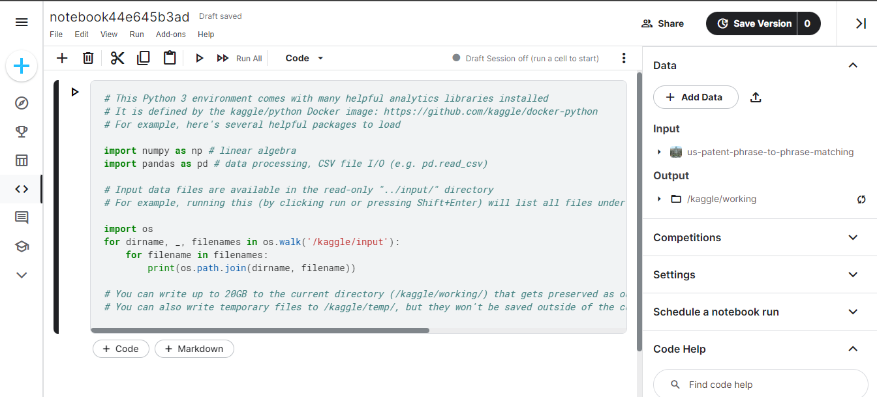
TECH STACK
The primary tech stack will be Python
I’ll primarily be using the Jupyter Notebook provided by Kaggle to code out my project as it provides a ready-made version-control mechanism and has an in-built save to Git feature.

Slide 10
PRELIMINARY APPROACH
OLS Regression: Render a new set of features equal to the unique values in ‘anchor’ and have a 0-1 binary encoding. The ‘score’ will then be used as a dependent variable and the new features as the independent variables.
GPT-3: This is a moonshot. But I will attempt to use GPT-3 to extract keywords from the ‘target’ and then categorize it basis the ‘context.’ Similar to GPT-3, categorizing text based on ESRB ratings.

Slide 11
REVISED APPROACH
BERT: Stands for Bidirectional Encoder Representations from Transformers. BERT is a type of neural network architecture that uses a Transformer model to generate word embeddings.
What sets BERT apart from other language models is its use of bidirectional training, which means that it can understand the context of a word based on both its left and right contents.
BERT is particularly effective for tasks requiring a deep language understanding
It is trained using a masked language modeling (MLM) task, in which a certain percentage of the input tokens are randomly masked, and the model is trained to predict the masked tokens based on the surrounding context

Slide 12
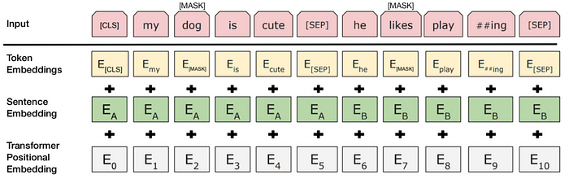
BERT Architecture

Slide 13
WHY BERT & NOT GPT
BERT could be used to generate embeddings for the phrases in the context of the CPC classification. The embeddings generated by BERT are context-aware, meaning they can capture the specific meaning of a word or phrase in a given context
Already pre-trained on a large corpus of text, so you don't need to train a language model from scratch.
BERT is trained on diverse text data, including books, articles, and web pages, while GPT is trained on web pages and books
BERT can handle out-of-vocabulary words effectively since it has a deep understanding of the underlying context of the text

Slide 14
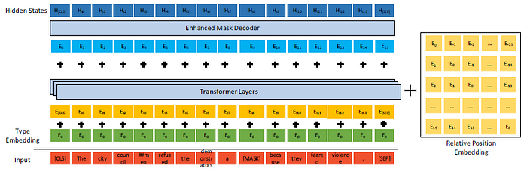
DeBERTa Architecture

Slide 15
DeBERTa CHARACTERISTICS
DeBERTa Stands for Decoding-enhanced BERT with Disentangled Attention
The DeBERTa V3 large model comes with 24 layers and a hidden size of 1024.
Disentangled attention allows the model to selectively attend to different aspects of the input sequence without interference
The above point can improve the model's ability to capture long-range dependencies and avoid redundancy in the learned representations
Trained on a combination of masked language modeling and next-sentence prediction tasks on a variety of large-scale datasets, such as the Common Crawl and Wikipedia

Slide 16
TRAINING APPROACH
Import the relevant datasets and packages
Tune the model hyperparameters
Do a 5-fold cross-validation with 5 epochs each

Slide 17
KEY CONCEPTS
Cross Entropy Loss: Cross-entropy loss is a commonly used loss function in NLP. It measures the difference between the target labels' predicted probability distribution and the true probability distribution.
By minimizing the cross-entropy loss, the model learns to classify input samples based on the given labels correctly
In NLP, the predicted probability distribution is generated by the soft-max function applied to the output of the model
Mathematically,
Where,
H() is the cross-entropy function;
P is the true probability distribution, and Q is the predicted probability distribution;
P(x) and Q(x) are the probabilities of the event x in P & Q, respectively;
the log is the base-2 logarithm
The negative sign in the formula for cross-entropy loss serves two purposes: it ensures that the loss is always positive, and it provides a gradient that points in the direction of minimizing the loss

Slide 18
KEY CONCEPTS (Contd.)
Stochastic Gradient Descent (SGD): an optimization algorithm used in NLP to train deep learning models. It works by iteratively updating the model parameters based on the gradients of the loss function with respect to the parameters
The gradient of the loss with respect to the parameters is estimated using a subset of the training data called a mini-batch
This makes the optimization process computationally efficient, as it avoids having to compute the gradient on the entire dataset simultaneously
The size of the mini-batch is a hyperparameter that can be tuned to balance the accuracy of the gradient estimation and the computational efficiency of the algorithm.
SGD uses a learning rate hyperparameter, which determines the step size for each update to the model parameters
Learning Rate | Outcome
High | Process may diverge from optimum outcome
Low | Process may take very long to converge

Slide 19
KEY CONCEPTS (Contd.)
Mechanism | Self-Attention | Disentangled Attention
Definition | A mechanism in which each word in a sentence attends to all other words in the same sentence | A mechanism that allows each word in a sentence to attend to a subset of the words based on their meaning
Applicability | Best suited for sequential tasks where the order of words is important, such as natural language translation | Best suited for tasks where the meaning of the words is more important than the order, such as text classification
Complexity | High complexity due to the need to attend to all other words in the sentence | Lower complexity due to attending to a subset of words
Interpretability | Lower interpretability due to attending to all words in the sentence | Higher interpretability as attention is focused on a subset of words
Performance | Good performance for sequential tasks | Good performance for tasks where the meaning of the words is more important than the order

Slide 20
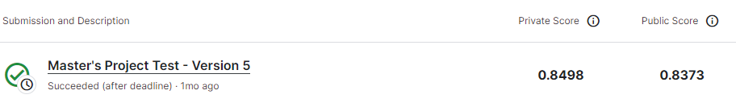
FINAL RESULTS

Slide 21
KEY LEARNINGS & POTENTIAL OUTCOMES
This project has been instrumental in getting me acclimated with key NLP concepts
Understanding the difference between BERT & GPT
Getting familiar with Transformers and how they’ve been instrumental in boosting NLP applications
Developed familiarity with different BERT models

Slide 22
IMPROVEMENT & FUTURE SCOPE
The project can be improved by using a more robust model with more training data
The hyperparameters in the configuration class were tuned inefficiently using hit-and-trial. Learning and implementing techniques like Random Search or Bayesian optimization is the plausible next step
The Google Patent repository and Google Patent Phrase Similarity dataset, which is a human-rated contextual phrase-matching dataset focused on patents, can be used to enhance this project further
Comparative studies of different NLP models for this task should be considered

Slide 23
SPILLOVER ADVANTAGES
The phrase-to-phrase match will have benefits limited to similar projects as the one above. The contextual establishment might have spillover effects in utilities that rely on Natural Language Processing (NLP), like Grammarly, Discord, etc., to improve their product offerings.

Slide 24
HOW ChatGPT HELPED ME
ChatGPT was instrumental in clarifying and providing web resources for further study of fundamental concepts like cross-entropy loss
The HuggingFace docs laid out the steps to configure the DeBERTa model in terms of including the relevant hyperparameters
However, for factors like being a beginner and the competition not allowing API integrations, I had to figure out how to lay the hyperparameters down
ChatGPT helped me create the ‘configuration’ class within the Kaggle environment to lay down the requisite hyperparameters
ChatGPT was also helpful in debugging, understanding code blocks/concepts from external sources, and effective memory management

Slide 25
ChatGPT PITFALLS
Trust but verify! ChatGPT can get things wrong or have outdated information
If you’re unclear about an explanation, feed the generated response, within quotations, back as a fresh prompt, and get it to clarify your doubt
Always get it to cite reputable web sources so that you have a starting point to do your due diligence
Incorrect or half-baked input will yield similar output

Slide 26
GITHUB
Feel free to go through, review, critique, and give suggestions -> https://github.com/aAnubhav2147/Masters_Project

Slide 27
REFERENCES & RESOURCES
Kaggle -> https://www.kaggle.com/competitions/us-patent-phrase-to-phrase-matching/overview
In the news -> https://www.nytimes.com/2022/04/16/opinion/patents-reform-drug-prices.html?referringSource=articleShare
Cooperative Patent Classification -> https://www.cooperativepatentclassification.org/Archive
The United States Patent & Trademark Office (USPTO) -> https://www.uspto.gov/web/patents/classification/cpc/html/cpc.html
Google Patent Phrase Similarity Dataset -> https://ai.googleblog.com/2022/08/announcing-patent-phrase-similarity.html?hl=ro&m=1

Slide 28
CONNECT?
Feel free to connect with me on LinkedIn -> https://www.linkedin.com/in/anubhav-shankar-grad/

